Slide 1
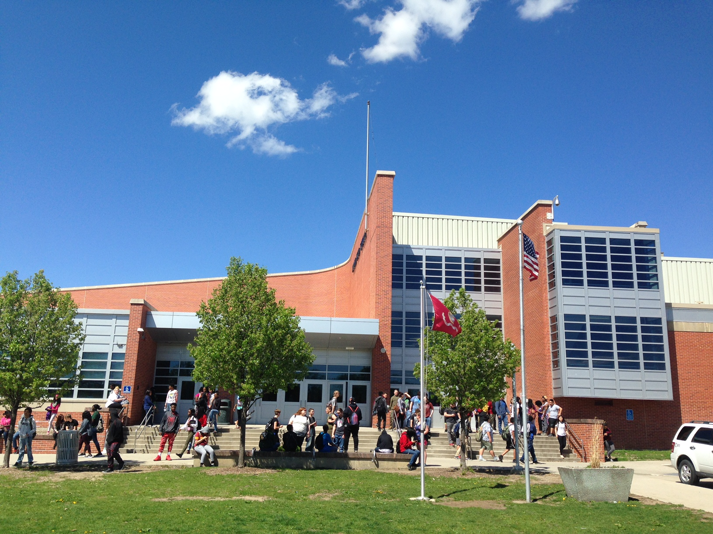
Class Meeting
Aug 28, 2017
11th & 12th Graders

Slide 2
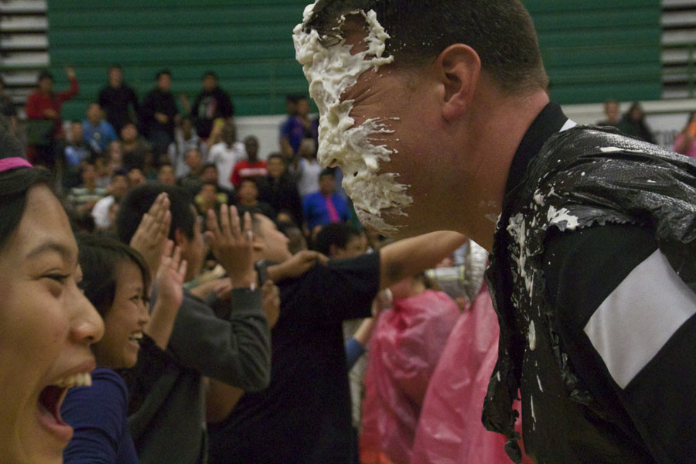
Ben Graeber, principal
Teacher for 15 years
Taught at North 2001-2004 &
2012-2014 (five school years)
SIL at North the last three years
My passion involves students getting involved in sports, activities, vocal music, theater, clubs, internships, and more...

Slide 3
Polar Bear Nation: It is time to celebrate
Pep Rally
This Friday, 2:05-2:40pm
Tailgate
This Friday, 4-6pm
Wear spirit gear
Every Friday

Slide 4
A few ways to stay informed...
Twitter
@DM_North
@nhspolarbears
@polarbearsfb
@polarbearsbball
@nhs_bearsden
@dmNHScounseling
@NorthCheerDM
@BenGraeberNHS
School website
north.dmschools.org

Slide 5
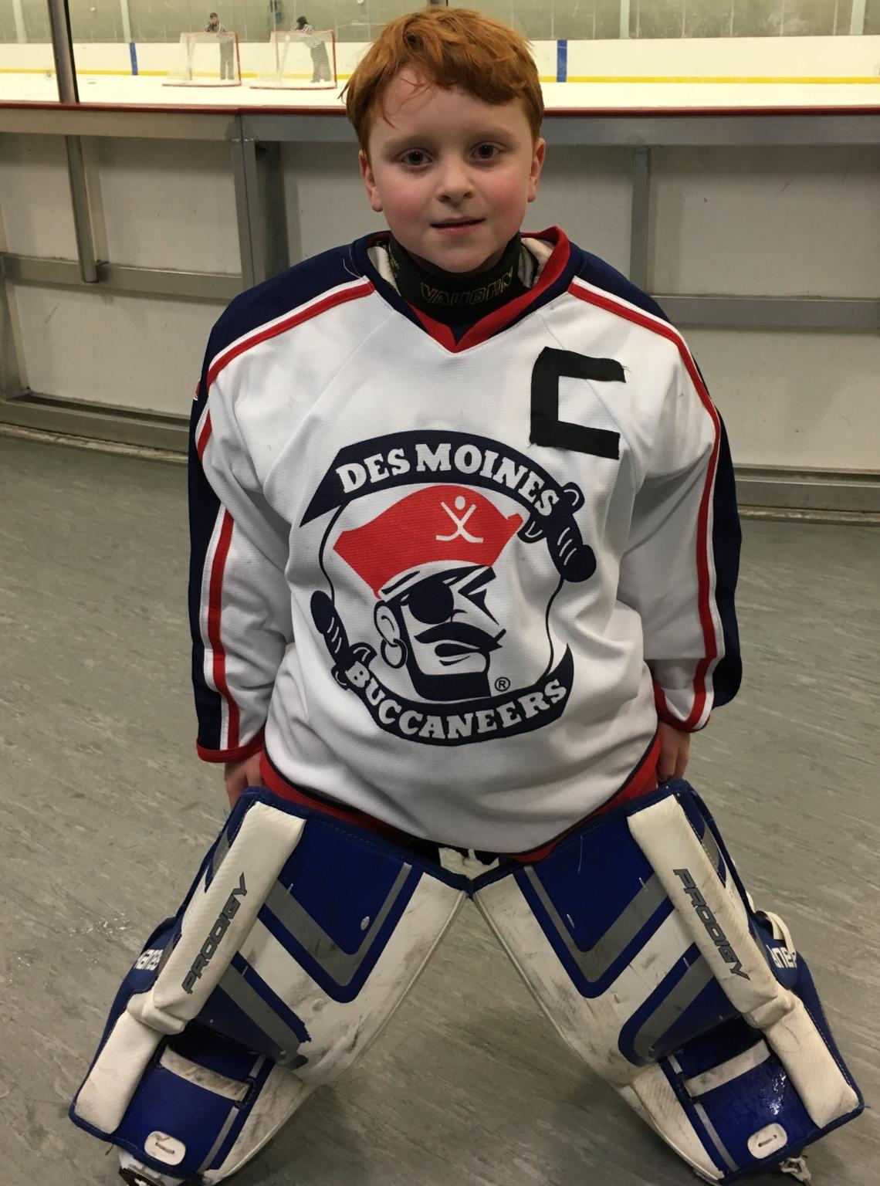
Cheryl Modlin, Vice Principal
In charge of the senior class!
VP at NHS since 2014
Passion: Building relationships that last a lifetime.

Slide 6
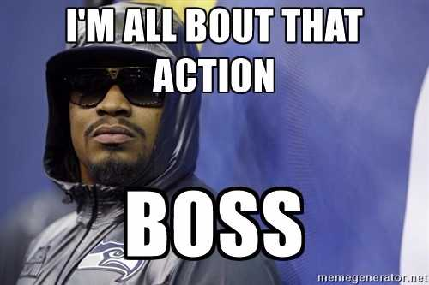
Joe Green, Vice Principal
In charge of the sophomore class
18 years teaching and leading in DMPS – SIL @ Hoyt MS last 7 yrs.
Passion for helping you discover purpose and inspiring hope.

Slide 7
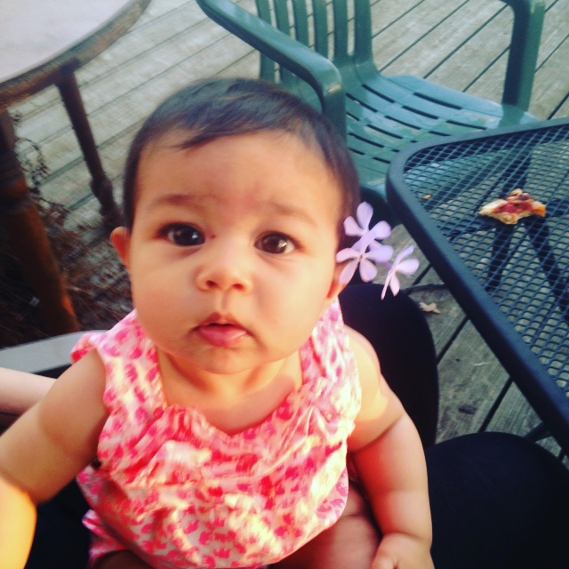
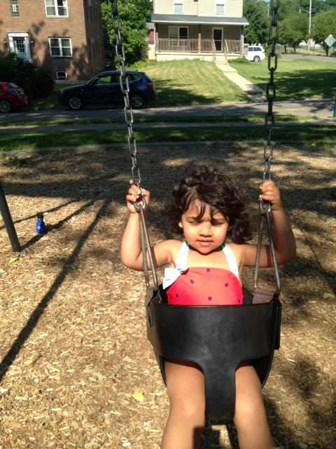
Praveen Bannikatti School Improvement Leader
In charge of the junior class
10th Year at North
Passion: For you to have the knowledge, skills, and abilities to accomplish your dreams and make a positive difference in our world.

Slide 8
Tori Rabe School Improvement Leader
In charge of the freshmen class
17 years in education (2nd year @ North)
Things I will help NHS with:
Post Prom
TV Displays
My passion = I want you to walk away with an unwavering belief in yourself!

Slide 9
Jon Johnson Athletics & Activities Director
Teacher for 7 years at Hiatt MS
At Risk Coordinator last 2 years at North
First year as AD
Passion- I have a passion to encourage all students to get involved in activities and athletics at North. I want to provide students an opportunity to be successful beyond the classroom.

Slide 10
Some of the activities that are available right now at North High
Newspaper
Yearbook
Robotics
Academic Decathlon
Cheerleading
Dance
Sisters for Success
Brother to Brother
Science Bound
Football
Cross Country
Volleyball
Golf
Movement 515
Band/Jazz Band/Percussion Ensemble
Two orchestras
Many different choirs

Slide 11
How do I buy a SAT pass?
$65 in the main office – new ID printed with a SAT ticket.
With SAT, you can get into any game, anywhere (except playoffs).

Slide 12
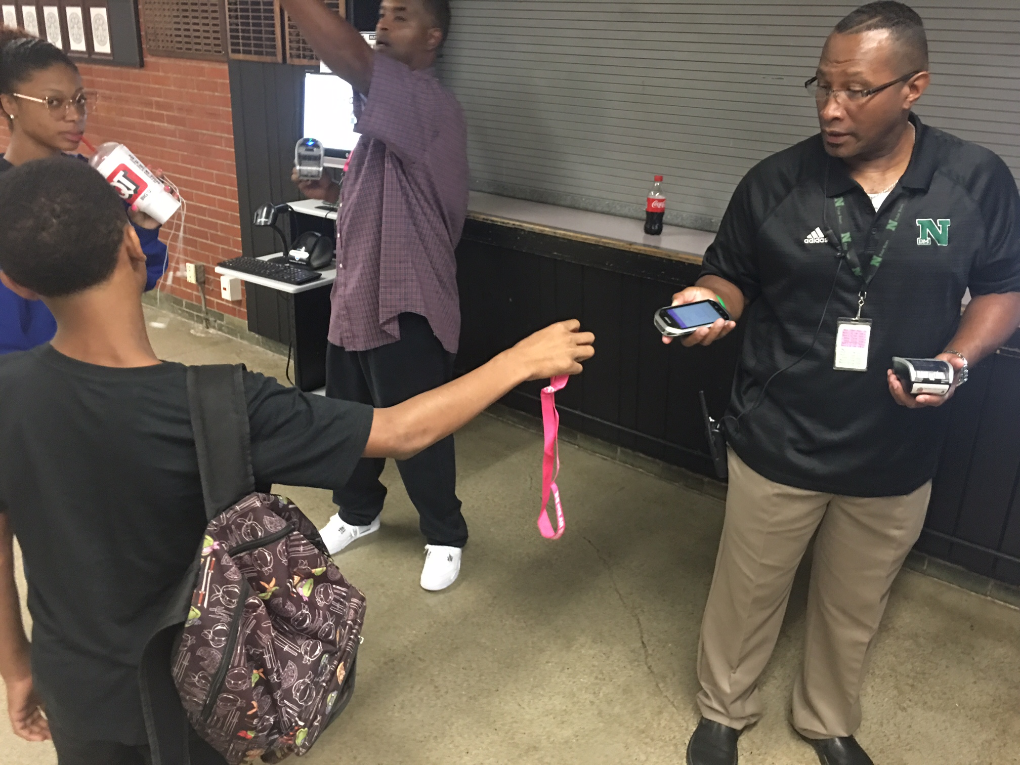
Wearing ID badges – why?
#1. You will need it to scan yourself in at North when tardy.
#2. B'fast
and lunch
#3. For your safety and the safety of others
#4. Bring ID to athletic events for proper entry and seating.
*Also, it is part of our dress code.

Slide 13
Scholarships & Graduation
*$100,000 just to North students
*Click on "counseling" from the north.dmschools.org website

Slide 14
In conclusion...
Watch this 6-minute video about North – it is from April 2017 (four months ago) and, as you watch, think about this...
Will you be in the video in April 2018?
What memories will you make this school year?
How will you make yourself and your family proud?
https://www.youtube.com/watch?v=WdkENX54qFo#action=share

