Slide 1
RAISE.ME
Micro-Scholarships
Beginning Freshman Year of High School

Slide 2
What is a Micro-Scholarship?
A Micro-Scholarship is an amount of money students are eligible to earn based on individual achievements throughout
9th-12th grade.
They are awarded by colleges and universities who partner with Raise.me, and each college or university creates their own program of Micro-Scholarships.

Slide 3
How much are the Micro-Scholarships Worth?
Each college can choose which achievements to award money for, and how much. For example, if you get an A in an English class, one college might award $500, another could award $1,000, and another, $50 - all for the same grade.
How much you make depends on the college you plan on attending.

Slide 4
What Colleges Offer Micro-Scholarships?
In Iowa
Drake University, Des Moines
Buena Vista University, Storm Lake
University of Iowa, Iowa City
Cornell College, Mount Vernon
Luther College, Decorah
Dordt College, Sioux Center
Briar Cliff University, Sioux City
Clarke University, Dubuque
*SENIORS*
Everyone of these colleges has a deadline for adding your information to collect money; be sure to check the deadlines and meet them!

Slide 5
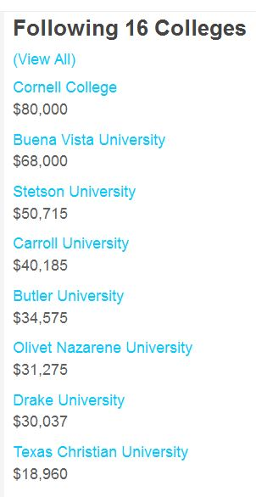
What if I am planning on attending college out of state?
There are many colleges located throughout the United States who offer micro-scholarships.
When you create an account, you can follow and link to as many or few colleges in and out of state to make a comparison of who will provide you with the most money.

Slide 6
What's the largest amount I can earn?
Colleges can set maximums on earnings for students via Raise.me. It could be $8,000 at one college, and $80,000 at another college.

Slide 7
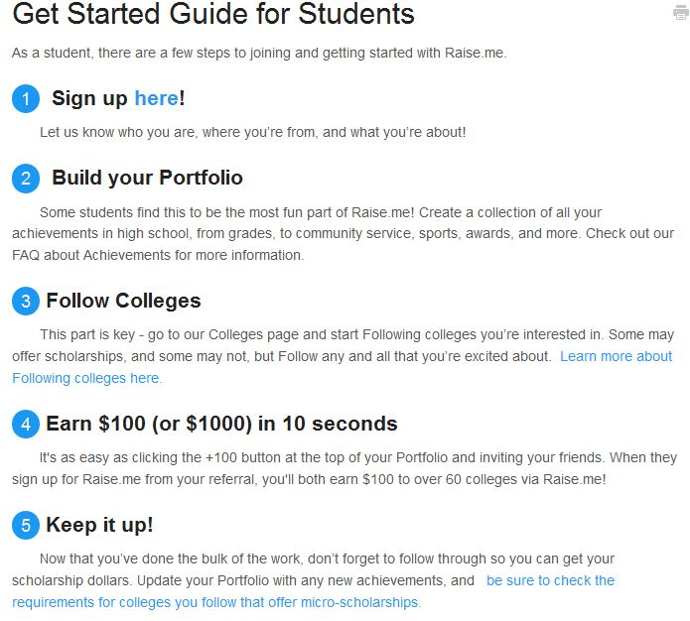
How Do I Apply?
1. Go to http://www.raise.me/signup
2. Make sure you’re seeing the page saying, “Student Sign Up” (If not, go to www.raise.me & make sure you’ve selected the page that says “Students” at the top, and click “Join” in the top right corner)
3. Enter your email address & a password you will remember.
4. Click “Continue”…

Slide 8
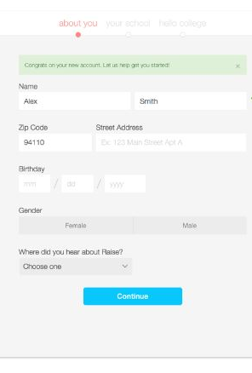
Profile
1. Once you log in, you will immediately see a page where you will fill out basic details like your name, address, birthday, gender, and where you heard about Raise.me.
2. This information will be a part of your student profile that you’re creating to start earning micro-scholarships.
3. Click “Continue”...

Slide 9
Add Your High School
Type in the name of your high school (you can click on the “?” button to help with your search).
2. Select how often you receive report cards (Semesters), and indicate the year you plan to graduate from high school.
3. Click “Continue”...

Slide 10
Hello, College!
You’re now ready to follow colleges! To get started, we’ve shown you a few suggestions. Choose as many as you’d like — the more you select, the more scholarship options you can access.
When you follow a school, you can see what each college requires in order to earn scholarship money (as well as other helpful tips, like what you need to do to apply to that college). If you meet the eligibility requirements of a school you’re following, you will automatically start earning money there every time you add an accomplishment on Raise.me.
If there is a college that you would like to see offering micro-scholarships on Raise.me, you can always go to the Colleges page and follow that college, and we’ll let you know when that college is added.
Click “Follow & Continue”...

Slide 11
Start Adding to Earn!
Congratulations, you now have a Raise.me account! Let’s pick something you’ve done to add to your profile to start earning scholarship money.
Do you play a sport? Have you earned a good grade? Are you part of a school club? Add anything you have done or accomplished now…

Slide 12
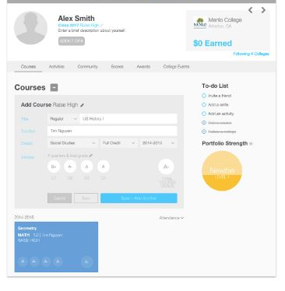
Continue to Add to Your Portfolio
For example, add a course and your grades — then click “Save + Add Another” to fill up your profile!
Take a minute to add something you’ve achieved — a sport, activity, community service, awards, college events, a grade... the list goes on!
All of these accomplishments are saved to your Portfolio page on Raise.me. This is where you will list the things you achieve in high school each month, and your achievements will determine how much money you earn

Slide 13
Congrats!
You just earned your first micro-scholarship!
If you haven’t earned an A or a B yet in a course, that’s okay — now you know that if you work hard to earn good grades, it can help you earn a lot of money for college and get accepted into more colleges.
Once you save your good grades and extracurricular activities to your profile, you can see immediately how much you earn for eligible colleges.
Let’s take a couple of minutes to add some more things to your profile...

Slide 14
How Can You Earn More Money for College?
First, make sure your portfolio is kept up to date!
There is a lot you can do to make your portfolio stronger by adding info. from 9th through 12th grades!
The to-do list on the right side of your portfolio page gives you tips for improving your profile.
The stronger your portfolio is, the more opportunities you’ll have to earn money for college

Slide 15
Important Tips…
When you earn micro-scholarships from a college, it does not mean that you have been admitted to that college.
Instead, it means that you are improving your chances of being admitted and being able to afford the cost of attending that college.
If you earn an amount of money from a college, you can only use that money to pay for that specific college — you cannot transfer your micro-scholarships between colleges.
Each college offers scholarship money that is only valid for attending that college.
Fortunately, when you do the things listed on your micro-scholarships portfolio and keep your profile of achievements up to date, you will earn money from many different colleges at the same time. When you apply to colleges, you will have more options to afford college using the money you have earned.

Slide 16
Keep Your GPA Up!
A minimum GPA is required by each college on Raise.me in order to unlock their micro-scholarships
For example, let’s say a college requires a 2.5 minimum GPA (usually a 2.5 means you have a mix of B’s & C’s in class).
If you earn a 2.5 GPA or higher, then the college will reward you scholarship money EVERY TIME you achieve any of the goals listed on their micro-scholarships page.
If your GPA is below the minimum required, then you know what you have to do in order to earn the colleges’ money — raise your GPA, you can do it

